Slide 1
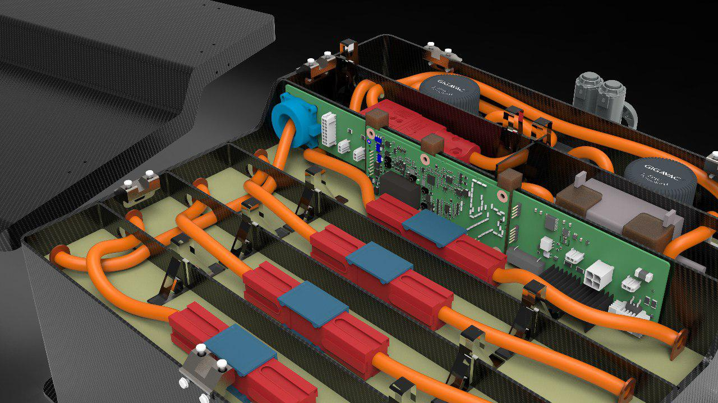
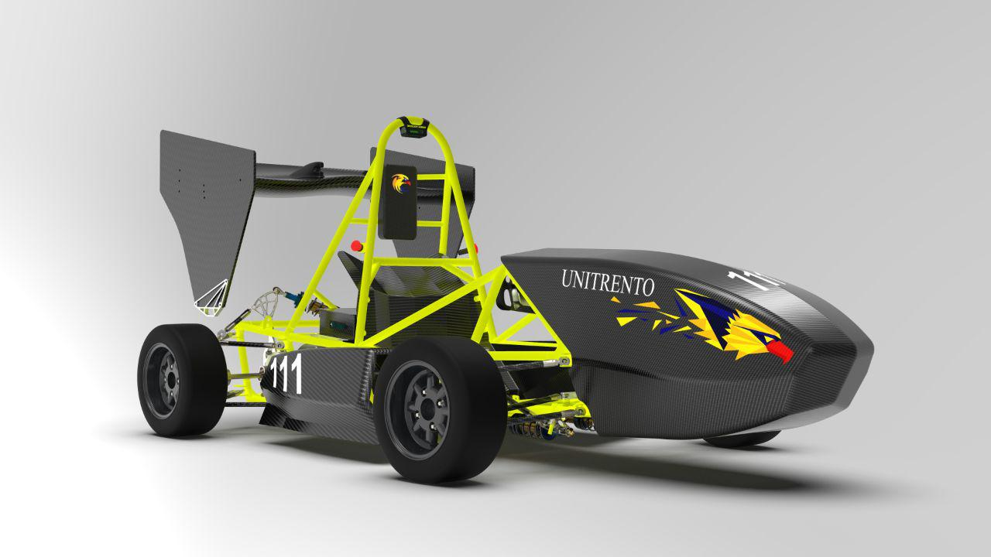
Battery management system realization on HV accumulator for FSAE vehicle

Slide 2
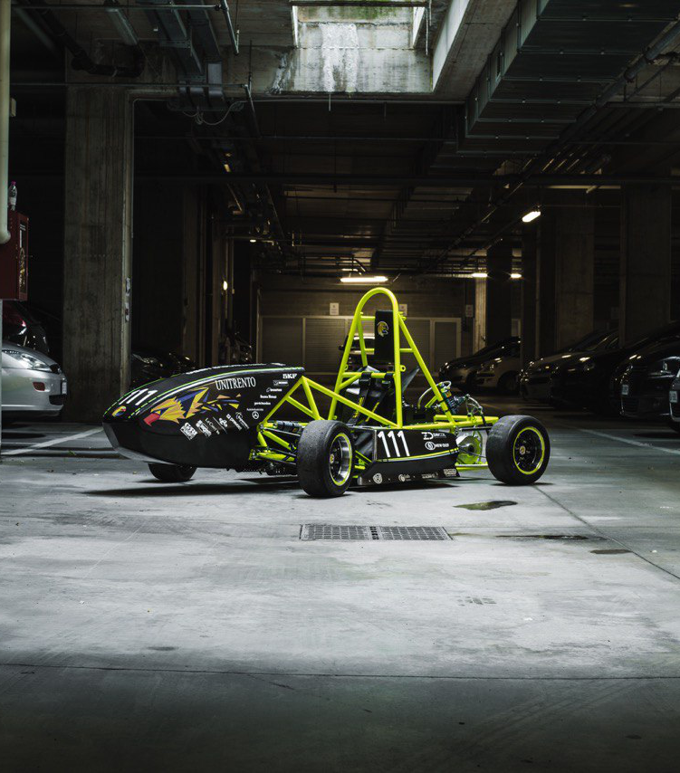
Formula SAE
International racing competition between univeristy
Vehicles developed and realized by students
Eagle Trento racing team was born in 2016
This is our second vehicle: Chimera EVO

Slide 3
Goal of the Battery Management System
Total voltage, single cell voltage and temperatures
Input and output current
Manages the Shut Down System to turn off the tractive system in fault cases
Comunication with the ECU to optimize the parameters to provide the best torque to the electric motors
Communication with the ECU and MCU to display the information on the steering wheel in real time
Manages of the cooling system of the accumulator analyzing the information about the internal temperatures

Slide 4
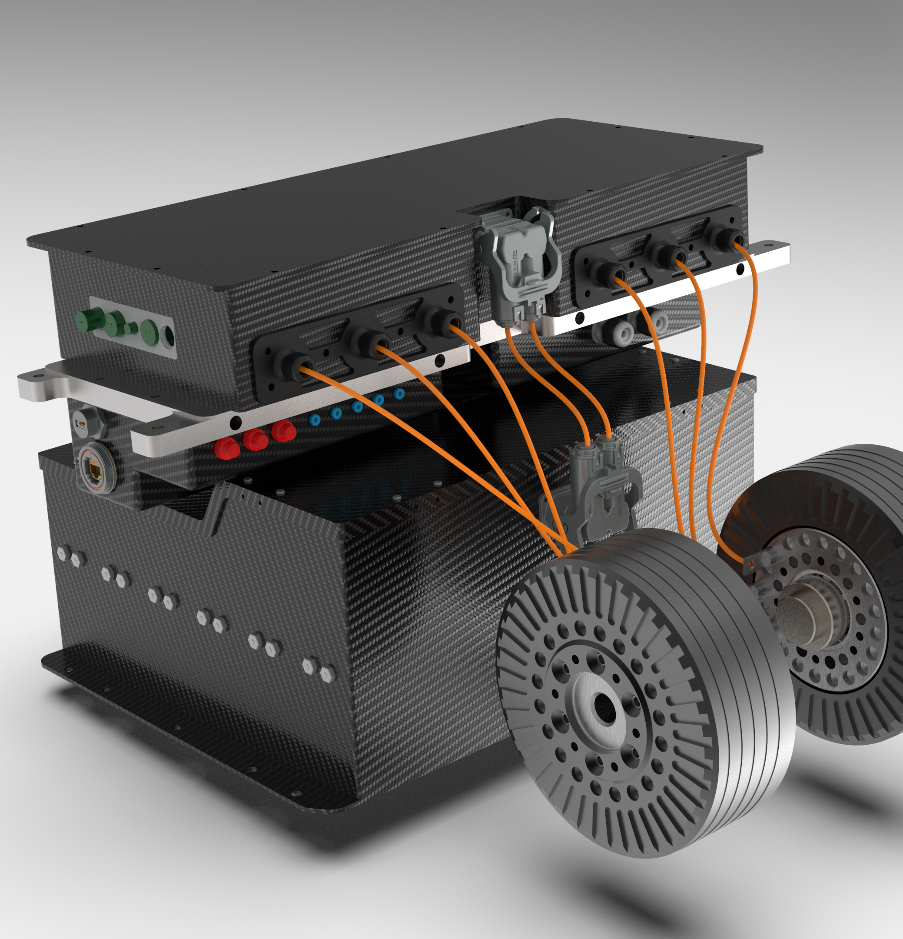
Tractive system configuration of Chimera
648 Sony VTC5 cells disposed in 108 series and 6 parallels in order to achieve 453V and 6kWh
Two emrax 228, 80 kW
Two inverters Bamocar D3 customized for our solution

Slide 5
Battery Management System
Centralized BMS:
Single Master
Distribuited BMS: Master to many Slaves, single communication channel
Hybrid BMS: Master to many Slaves, many communication channels

Slide 6
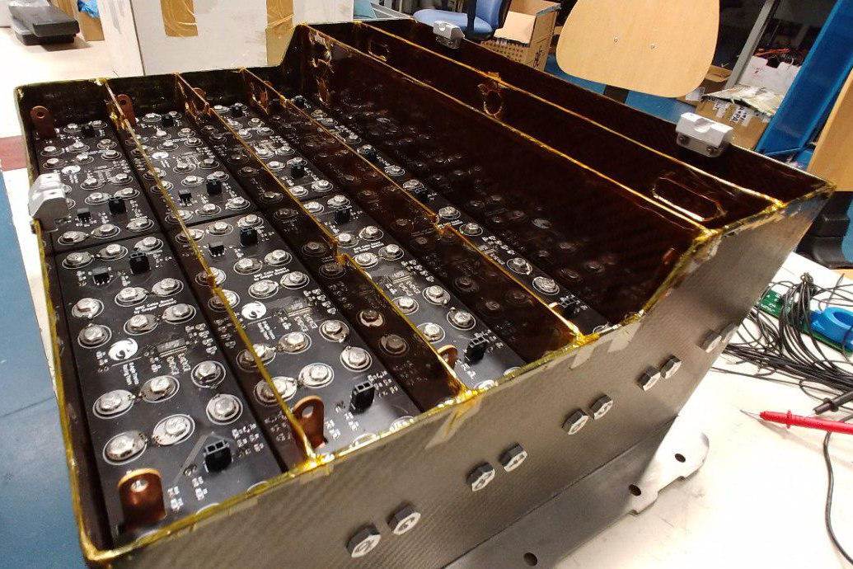
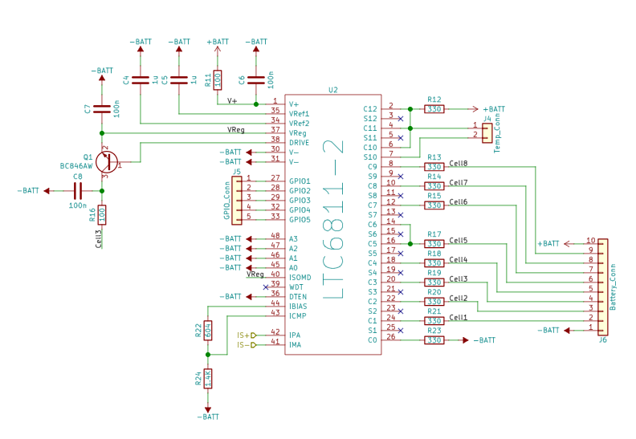
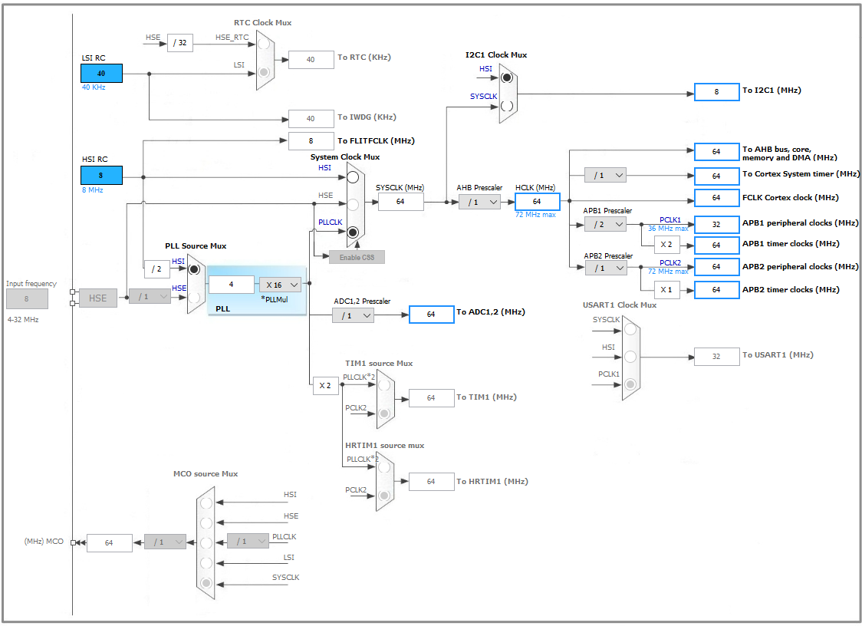
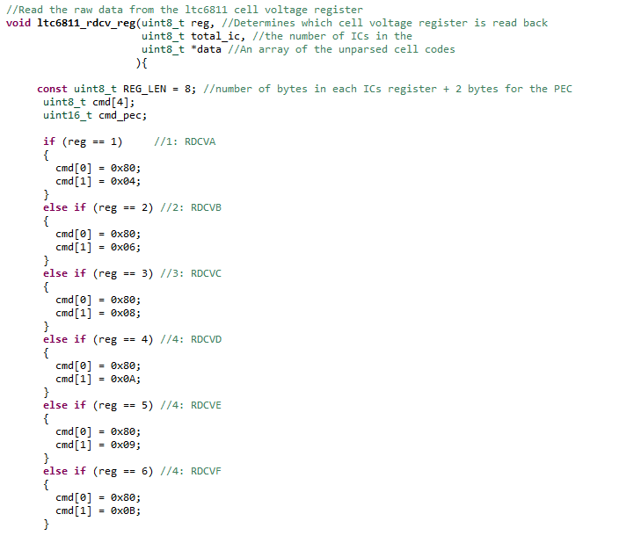
HW development:
PCBs was designed by another member of the team
SW development:
The software was developed in C on a STM32 MCU
The BMS application was developed with qt library in C++

Slide 7
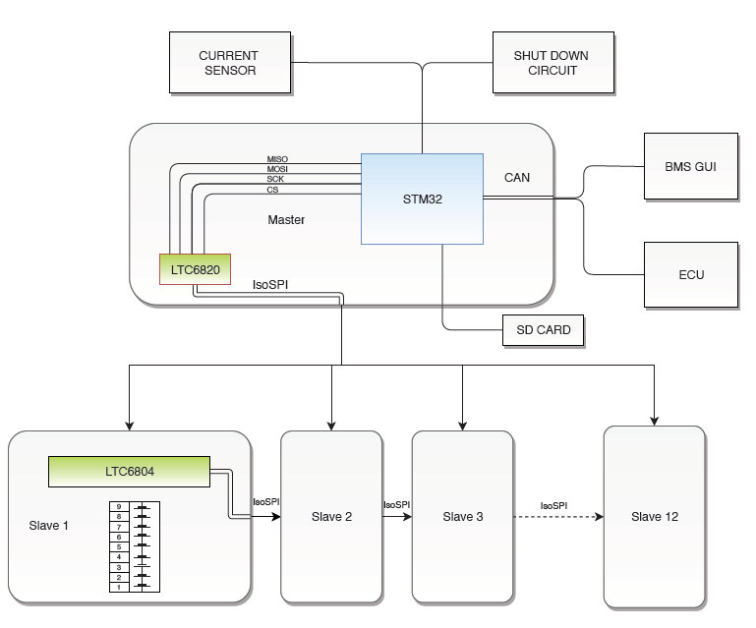
Main architecture of BMS

Slide 8
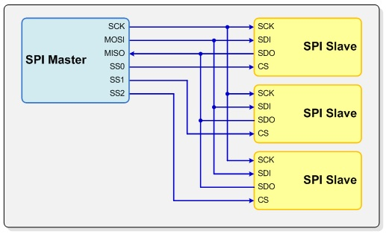
Data acquisition system:
Cells voltage and temperature acquired by each LTC6804 and sent through isoSPI propetary protocol to LTC6820
These data are transferred via SPI (serial peripherals interface) to the MPU stm32
Each data sent is logged on an SD card
SPI implementation
MISO (master in slave out): Slave line for sending the data to the master
MOSI (master out slave in): Master line for sending data to peripherals
SCK(serial clock): synchronize data transmission
CS(chip select): enable/disable specific slave device

Slide 9
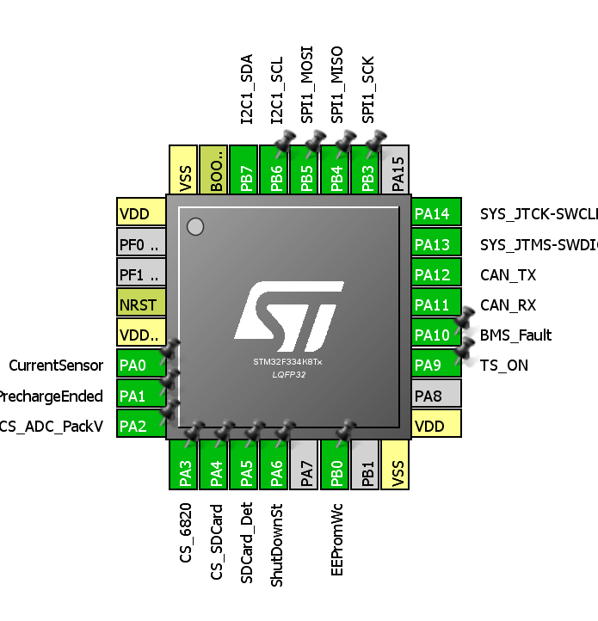
Data acquisition system MCU
General Purpose Input/Output(GPIO):
Current data
Total pack and tractive system voltage
Status pins of the Shut Down System BMS_Fault, TS ON, Shut Down Status, Precharge Ended
Logging pin(SD card, EEPROM memory)

Slide 10
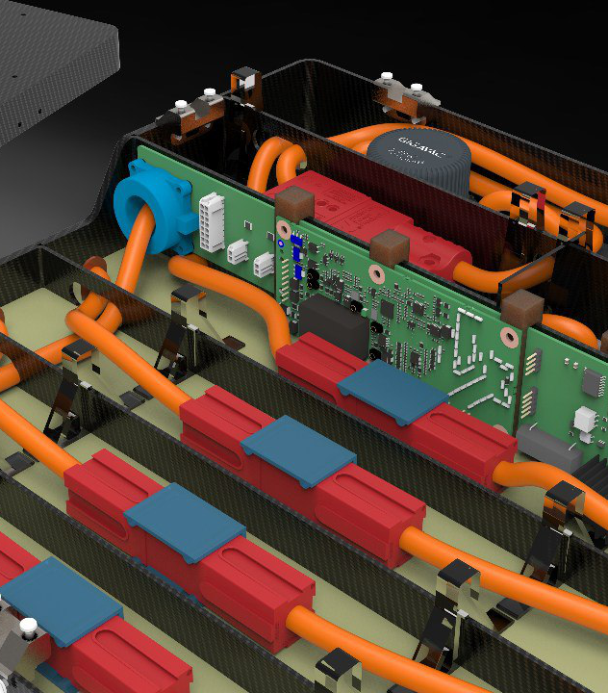
Current sensor
Current data acquired by Hall effect Current trasducers sensor that exploits the variations of the magnetic field.Data is sampled by an internal ADC of the MCU
LEM HTFS 200-P:
Single 5V supply
+/- 300 A Range current

Slide 11
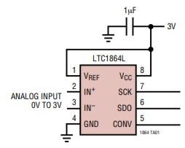
Tractive system ADC
Total pack and tractive system voltage acquired by an external ADC, LTC1865
Single ended connection
Offers a software selectable 2-channel MUX and an external reference pin
Single 3V supply
16-bit 150kbps
Disturbances isolated

Slide 12
Security systems: HV precharge
Every time tractive system CAN message is received
BMS loop until the TS voltage is equal to the Total pack voltage through the external ADC
Precharge circuit ON
ON signal is sent the ECU at the of the procedure and TS is powered on

Slide 13
Security systems: Shutdown circuit
Constant monitor under/over voltage/temperature, over current
In case of receving FAULT messages form any other sensors of the car , the shutdown system occurs
Instantaneous opening of relays of the poles of the battery pack

Slide 14
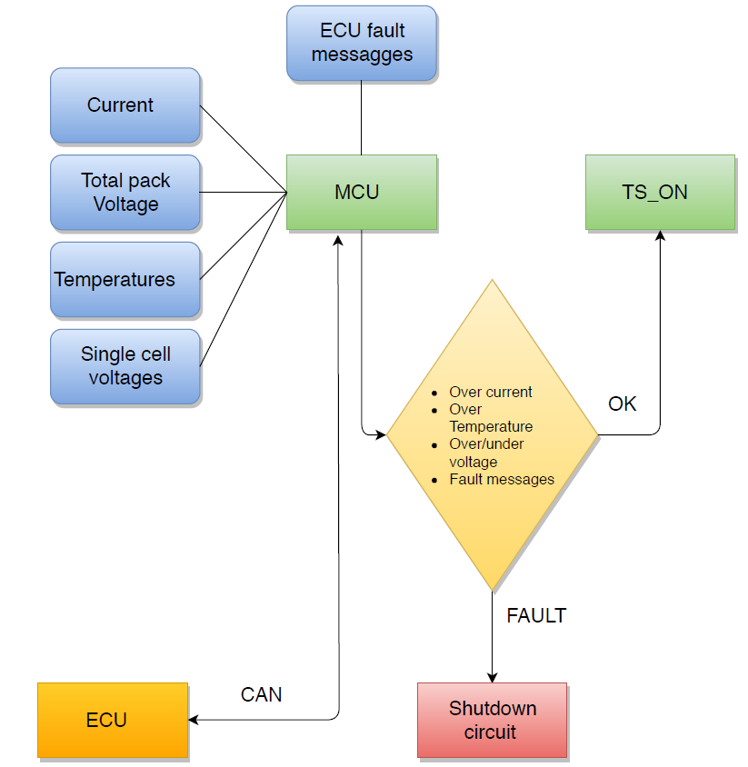
Data transmission
During acquisition cycle, that lasts 10 ms, the data are sent through CAN bus protocol to the ECU
All data will be trasmitted on CAN bus:
Current
Average Temperature
Total Pack Voltage
Maximum and minimum cell voltage
Check ok / Check fault
Fault type

Slide 15
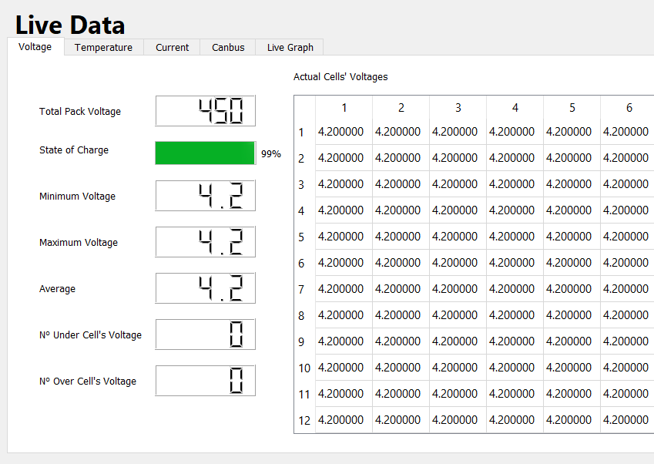
Graphic user interface
Developed using QT library in c++
The software display the parameters acquired in the DAS
Serial/CAN communicaion
Live data

Slide 16
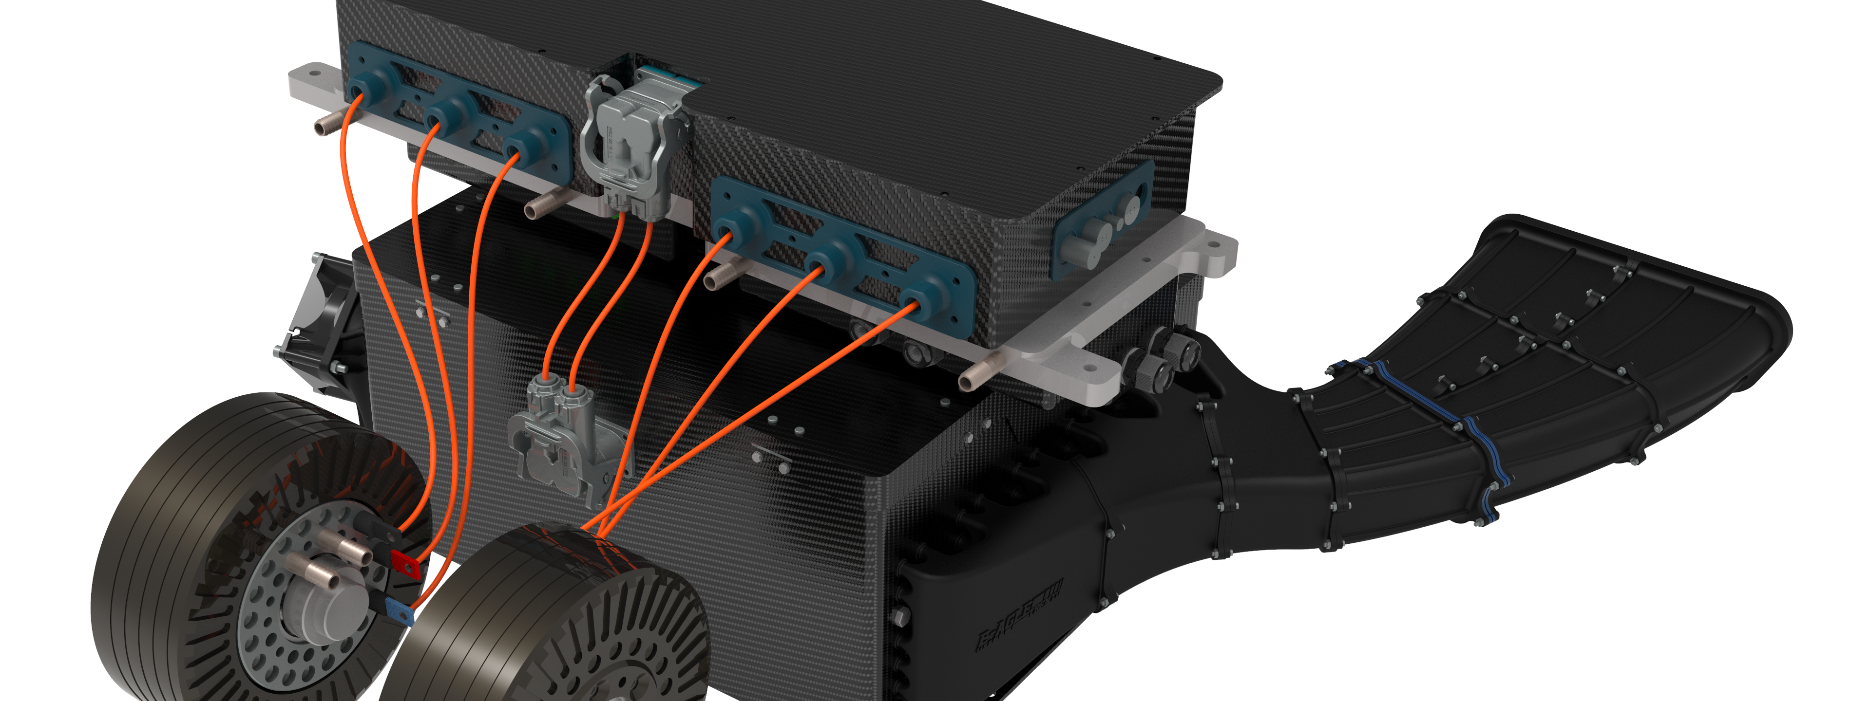
Future developement
Cells balancing implementation
Wi-Fi Protocol communication
Cooling system control
More flexible software

